Slide 1
BDM CAPSTONE PROJECT
Market Basket analysis and inventory optimization through data mining for a low-growth organic food store
By Devansh Singh Parmar
Student Email ID: 21f1001594@ds.study.iitm.ac.in
Roll No: 21f1001594

Slide 2
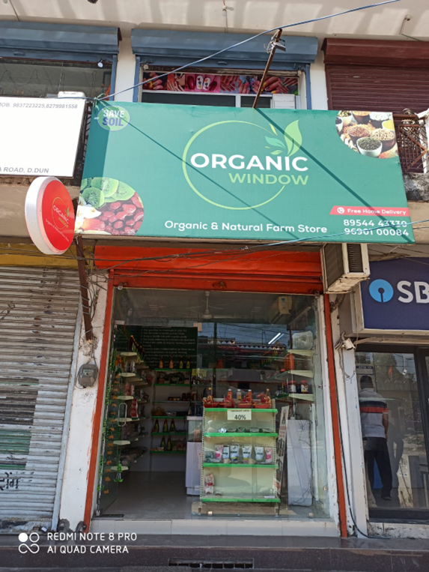
Organisation Background
Organic Window is a small business established in March 2022, located in Dehradun, the capital of Uttarakhand, India.
The product range at Organic Window includes everyday groceries like organic rice, pulses, and flour, as well as unique state-specific food products such as Buransh (Rhododendron juice), chutneys, pahadi pulses, and pahadi spices.
The products are sourced from different companies which include Samridhi and natureland along with other local companies.

Slide 3
Problems & Objectives
PROBLEMS FACED:
OBJECTIVES:
Sourcing of products left fewer margins for organic window. This is around 18-22 %
Overcoming Organic Window's identity crisis and establishing a stronger brand image.
Given Dehradun is a Tier 2 has much less spending power than Tier 1 cities and are unwilling to pay a premium for organic products
Identifying opportunities for increasing sales and profit at Organic Window.
This has resulted in low Sales and demand no constant growth for the store.
Trend Analysis, analyzing impact of weather patterns on sales
Break even for organic window stands ar 70,000 Rs a month which they have never reached
Analyzing different sales channels and prioritizing resource allocation.

Slide 4
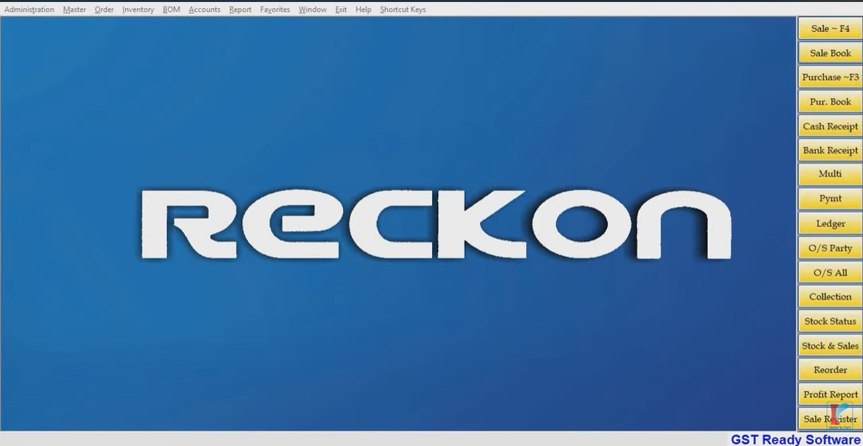
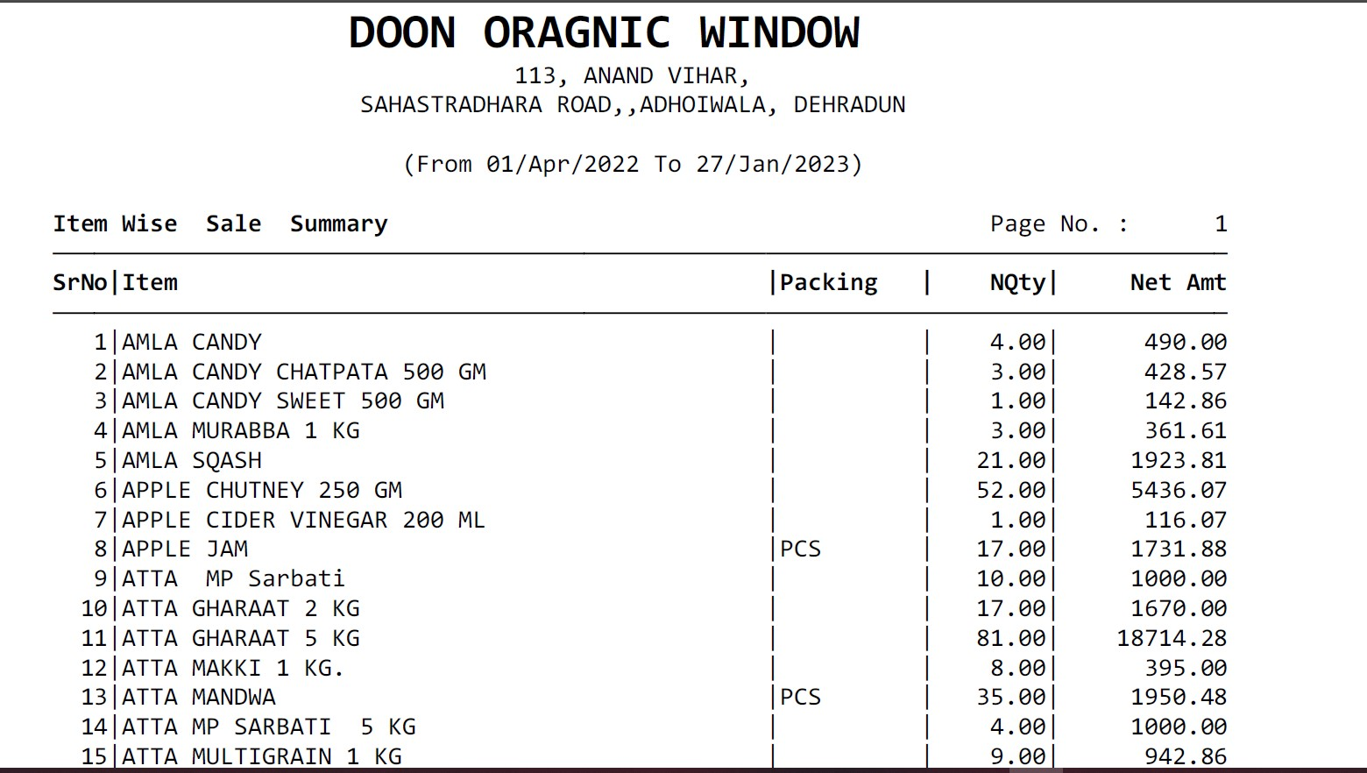
DATA COLLECTION AND PREPROCESSING
The data collected spans from April 16, 2022, to January 27, 2023, providing a substantial dataset for analysis and insights.
The primary source of data is the Recon software, which is a point-of-sale system used by Organic Window. The data was accessed remotely using software called AnyDesk.
The collected data from POS was initially in PDF. Each PDF was converted into spreadsheets for analysis. These spreadsheets include item-wise sales and revenue history, month-wise revenue, and date-wise revenue etc
Steps involving Cleaning & processing:
Correcting format of converted excel sheets. This involved:
Removing unnecessary lines
Removing Spaces
Alignment
Handling missing values
Handling Misleading or faulty values

Slide 5
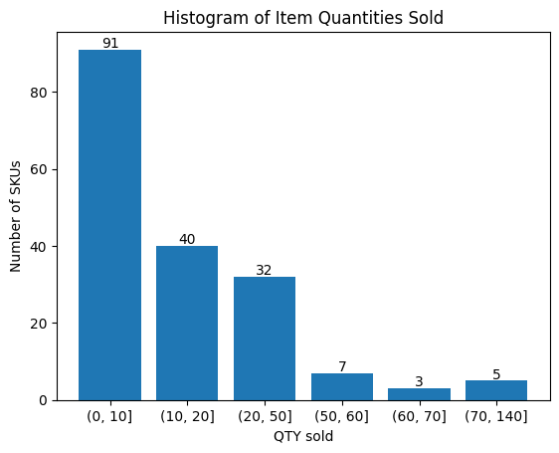
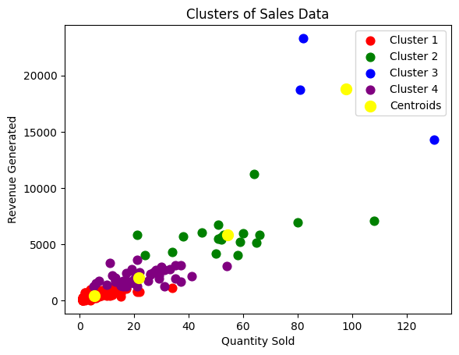
Objective 1: Overcoming Organic Window's identity crisis and establishing a stronger brand image.
Conducted analysis using Pareto chart, histogram, and scatter plots.
Discovered a concentration of sales and revenue among a few key products.
Conducted Cluster Analysis using K-means algorithm.
The graph basically depicts that in total of 227 days of sales, there were 91 such SKUs that each have sales either less than or equal to 10.
Optimal number of clusters determined as 4.
Identified clusters represent different priority groups based on sales and revenue patterns.
Top 5 performing SKUs: BURASH, JAGGERY POWDER, MUSTARD OIL, ATTA GHARAAT, MALTA SQUASH.
Example: Cluster 1 (worst performing) has the most SKUs. (106)
Notably, the top-performing SKUs include non-organic and pahadi products, deviating from Organic Window's initial mission.

Slide 6
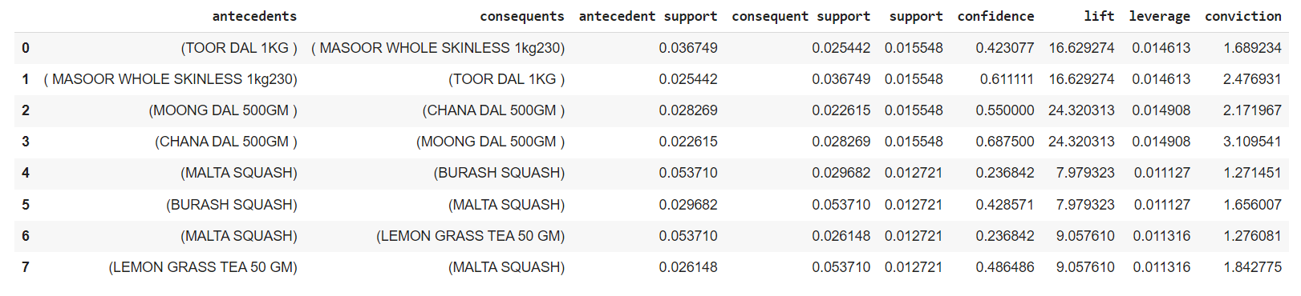
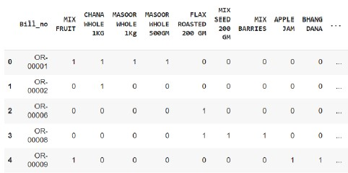
Objective 2:Identifying opportunities for increasing sales and profit at Organic Window.
Identified several useful associations with notable statistics:
a. (MASOOR WHOLE SKINLESS 1kg) & (TOOR DAL 1KG)
- Support: 0.0166, Lift: 16.63, Conviction: 2.477, Confidence: 0.611111
b. (CHANA DAL 500GM) & (MOONG DAL 500GM)
- Support: 0.016, Lift: 24.32, Conviction: 3.11, Confidence: 0.687500
c. (LEMON GRASS TEA 50 GM) & (MALTA SQUASH)
- Support: 0.012721, Lift: 9.057, Conviction: 1.842, Confidence: 0.486
d. (BURANSH SQUASH) & (MALTA SQUASH)
- Support: 0.012721, Lift: 7.98, Conviction: 1.656007, Confidence: 0.428571
Conducted MBA on a basket matrix of 1,415 bills (rows) and 339 SKUs (columns) using Apriori algorithm, with a minimum support threshold of 0.012

Slide 7
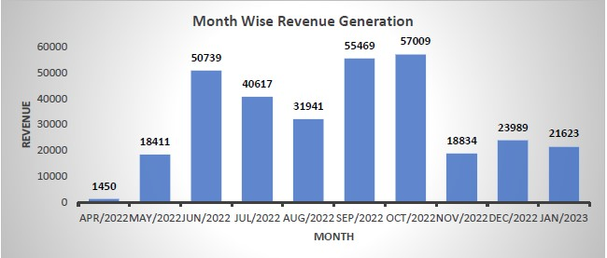
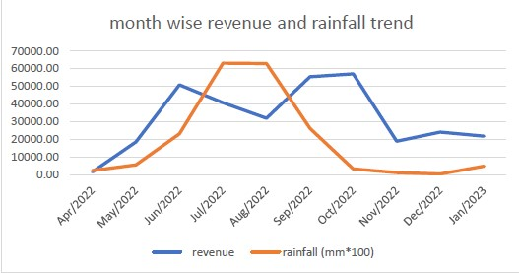
Objective 3 & 4: Analyzing data on weather patterns to identify potential impacts on sales & determining the priority channels and identifying the channels with the highest ROI for appropriate resource Allocations
A glance at Month wise revenue generation reveals a significant drop in revenue during the months of july and august
Given dehradun is a valley city, it faces significant amount of rainfall in monsoon season.So I decided to check whether rainfall is affecting sales negatively
The analysis revealed that rainfall does seem to have a negative impact on revenue generated by Organic Window. During the months of July and August, when rainfall is highest, there is a noticeable drop in revenue. Conversely, when rainfall decreases, revenue returns to previous levels or even surpasses them.
To mitigate the negative impact of the monsoon season on their revenue the owners decided to hire a delivery man who would deliver orders to customers home directly

Slide 8
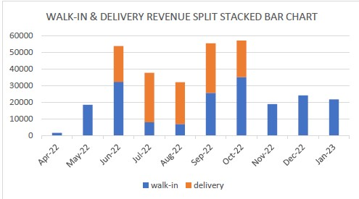
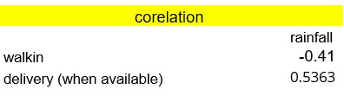

Objective 3 & 4: Analyzing data on weather patterns to identify potential impacts on sales & determining the priority channels and identifying the channels with the highest ROI for appropriate resource Allocations
The walk-in revenue drastically decreases during monsoon months
The revenue through delivery remains robust in monsoon months.
In contrast the revenue through delivery was found to be increases in monsoon months, compensating for lack of incoming customers to the shop.
Delivery revenue performed well during the monsoon season, but issues with the delivery person resulted in the discontinuation of delivery service after the month of october.
Correlation on monthly basis
Correlation for the month of august
The absence of a reliable delivery channel seems to have a significant loss of revenue opportunity in months of October, December, January. Hence highlighting the importance of delivery channel for the organic food store

Slide 9
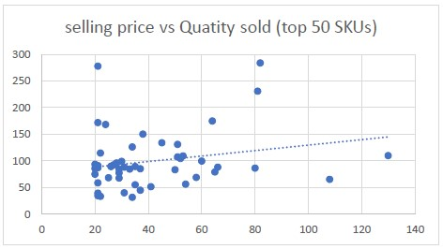
Interpretation of Results and Recommendation
SKU Lineup Optimization: Cluster 4 from cluster analysis are our priority 1 group. They will be the face of organic window and should never run out of stock. For Cluster 3 products prices can be varied to check for elasticity and potential increase in revenue through thes
For cluster 2 , these products are to be stocked in low quantities where as all cluster 1 products are to be discarded.
In the SP vs Quantity sold graph it appears that higher selling prices may not have a negative impact on sales. In fact, there seems to be an upward trendline in the graph.This indicates that the products are of good value as they offer higher utility to customers even after higher costs.
Organic window also displays a repeat customer rate of 24.8 % which is not bad from industry standards.
I believe with the recommended line-up of products this repeat rate can increase further.This can prove to be quite beneficial as it would increase the brand value of organic window, therefore increasing word-of-mouth which will help in driving further sales.
Given the above two points I can conclude that there is not much of a product quality issue( for priority 1, 2 products).
Monsoon Season Preparedness: Anticipate the negative impact of the monsoon season on sales, especially in July and August with high rainfall. Consider reducing stock levels, employing a delivery sales model, or a combination of both. Invest in hiring a new delivery person to capitalize on the growth potential of the delivery channel.
Utilize Market Basket Analysis (MBA): Implement MBA findings to boost sales through various strategies such as bundle promotions, cross-selling, product recommendations, and seasonal promotions. These associations will be particularly valuable if Organic Window decides to shift to a Direct-to-Customer (DTC) model.

Slide 10
Thank You

